Slide 1


Multimedia and Quality of Service: What is it?
multimedia applications: network audio and video
(“continuous media”)
QoS
network provides application with level of performance needed for application to function.

Slide 2
Unit 5: goals
Principles
classify multimedia applications
identify network services that apps need
making the best of “best effort” service
Protocols and Architectures
specific protocols for best-effort
mechanisms for providing QoS
architectures for QoS

Slide 3
Unit 5 outline
5.1 multimedia networking applications
5.2 streaming stored audio and video
5.3 making the best out of best effort service
5.4 providing multiple classes of service
5.5 providing QoS guarantees

Slide 4

MM Networking Applications
Classes of MM applications:
1) stored streaming
2) live streaming
3) interactive, real-time
Fundamental characteristics:
typically delay sensitive
end-to-end delay
delay jitter/variation
loss tolerant: infrequent losses cause minor glitches
antithesis of data, which are loss intolerant but delay tolerant.
Jitter is the variability
of packet delays within
the same packet stream
Notes:
Antithesis
n.
对立面
antithesis
英 [ ænˈtɪθəsɪs ] 美 [ ænˈtɪθɪsɪs ]
GRE
n.对立 对立面 对照 对偶
变形复数： antitheses

Slide 5

Streaming Stored Multimedia
Stored streaming:
media stored at source
(e.g., YouTube)
transmitted to client
streaming: client playout begins before all data has arrived
timing constraint for still-to-be transmitted data: in time for playout

Slide 6
Streaming Stored Multimedia: What is it?
Cumulative data
2. video
sent
1. video
recorded
3. video received,
played out at client
network
delay
time
streaming: at this time, client
playing out early part of video,
while server still sending later
part of video

Slide 7
Streaming Stored Multimedia: Interactivity
streaming MM clients
RealPlayer
QuickTime
Windows Media Player
VCR-like functionality: client can pause, rewind, fast forward, push slider bar
10 sec initial delay OK
1-2 sec until command effect OK
timing constraint for still-to-be transmitted data: in time for playout
Notes:
videocassette recorder 盒带式录像机(VCR)

Slide 8
Real-Time Interactive Multimedia
applications: IP telephony, video conference, distributed interactive worlds
end-end delay requirements:
audio: < 150 msec good, < 400 msec OK
includes application-level (packetization) and network delays
higher delays noticeable, impair interactivity

Slide 9
Multimedia Over Today’s Internet
TCP/UDP/IP: “best-effort service”
no guarantees on delay, loss
?
?
?
?
?
?
But you said multimedia apps requires
QoS and level of performance to be
effective!
?
?
?
?
?
Today’s Internet multimedia applications
use application-level techniques to mitigate
(as best possible) effects of delay, loss

Slide 10
How should the Internet evolve to better support multimedia?
Integrated services philosophy:
fundamental changes in Internet so that apps can reserve end-to-end bandwidth
requires new, complex software in hosts & routers
Laissez-faire
no major changes
more bandwidth when needed
content distribution, application-layer multicast
application layer
Differentiated services philosophy:
fewer changes to Internet infrastructure, yet provide 1st and 2nd class service
What’s your opinion?
Notes:
laissez-faire
英 [ ˌleseɪ ˈfeə(r) ] 美 [ ˈfer ]
adj.[法]放任主义的，自由放任的 =“laisser-faire”
n.自由放任主义，无干涉主义

Slide 11
Three approaches to supporting MM app.
Approach | Unit of allocation | Guarantee | Deployment to date | Complexity | Mechanisms
making the best of best-effort service | none | none or soft | everywhere | minimal | application layer support, CDN, over-provisioning
differential QoS | classes of flows | none or soft | some | medium | policing, scheduling
guaranteed QoS | individual flows | soft or hard, once a flow is admitted | little | high | policing, scheduling, call admission and signalling
hard guarantee – the application will receive its requested QoS with certainty.
soft guarantee – the application will receive its requested quality of service with high probability.
content distribution networks (CDNs) replicate stored content and put the
replicated content at the edges of the Internet. CDNs provide a differentiated service to content providers.

Slide 12
Unit 5 outline
5.1 multimedia networking applications
5.2 streaming stored audio and video
5.3 making the best out of best effort service
5.4 providing multiple classes of service
5.5 providing QoS guarantees

Slide 13
Streaming Stored Multimedia
application-level streaming techniques for making the best out of best effort service:
client-side buffering
use of UDP versus TCP
multiple encodings of multimedia
Media Player
jitter removal
decompression
error concealment
graphical user interface
controls for interactivity

Slide 14
Streaming Multimedia: Client Buffering
constant bit
rate video
transmission
client video
reception
constant bit
rate video
playout at client
Cumulative data
variable
network
delay
buffered
video
client playout
delay
time
client-side buffering, playout delay compensate for network-added delay, delay jitter

Slide 15
分组
发出
t
1 2 3 4 5 6
cumulative data
6
5
4
3
2
1
❶playout delay
late packet
No network delay
network delay
❷playout delay
further
buffer time
packet 1’s delay
buffered
t
1 2 3 4 5 6
real network
packets
arrive
t
1 2 3 4 5 6

Slide 16
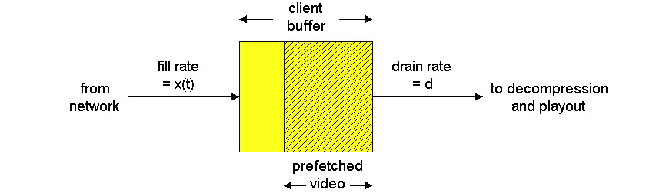
Streaming Multimedia: Client Buffering
variable fill rate, x(t)
constant
drain rate, d
buffered
video
loss may occur
buffer (FIFO queue)
t
t
variable rate
constant rate
playout delay

Slide 17
Streaming Multimedia: UDP or TCP?
UDP
server sends at rate appropriate for client (oblivious to network congestion!)
often send rate = encoding rate = constant rate
then, fill rate = constant rate - packet loss
short playout delay (2-5 seconds) to remove network jitter
TCP
send at maximum possible rate under TCP
fill rate fluctuates due to TCP congestion control
larger playout delay: smooth TCP delivery rate
HTTP/TCP passes more easily through firewalls
Notes:
oblivious
英 [ əˈblɪviəs ] 美 [ əˈblɪviəs ]
adj.忘却的 健忘的 不注意的 不知道的

Slide 18
Streaming Multimedia: client rate(s)
1.5 Mbps encoding
28.8 Kbps encoding
Q: how to handle different client receive rate capabilities?
28.8 Kbps dialup
100 Mbps Ethernet
A: server stores, transmits multiple copies of video, encoded at different rates

Slide 19
Unit 5 outline
5.1 multimedia networking applications
5.2 streaming stored audio and video
5.3 making the best out of best effort service
5.4 providing multiple classes of service
5.5 providing QoS guarantees

Slide 20
Internet Phone: Packet Loss and Delay
network loss: IP datagram lost due to network congestion (router buffer overflow)
delay loss: IP datagram arrives too late for playout at receiver
delays: processing, queuing in network; end-system (sender, receiver) delays
typical maximum tolerable delay: 400 ms
loss tolerance: depending on voice encoding, losses concealed, packet loss rates between 1% and 10% can be tolerated.

Slide 21
Delay Jitter
constant bit
rate
transmission
client
reception
constant bit
rate playout
at client
Cumulative data
variable
network
delay
(jitter)
buffered
data
client playout
delay
time
consider end-to-end delays of two consecutive packets: difference can be more or less than 20 msec (transmission time difference)
Notes:
Jitter is a variation in packet latency for voice packets.

Slide 22
Content distribution networks (CDNs)
Content replication
challenging to stream large files (e.g., video) from single origin server in real time
solution: replicate content at hundreds of servers throughout Internet
content downloaded to CDN servers ahead of time
placing content “close” to user avoids impairments (loss, delay) of sending content over long paths
CDN server typically in edge/access network
origin server
in North America
CDN distribution node
CDN server
in S. America
CDN server
in Asia
CDN server
in Europe

Slide 23
More about CDNs
routing requests
CDN creates a “map”, indicating distances from leaf ISPs and CDN nodes
when query arrives at authoritative DNS server:
server determines ISP from which query originates
uses “map” to determine best CDN server
CDN nodes create application-layer overlay network

Slide 24

Summary – Internet Multimedia: bag of tricks
use UDP to avoid TCP congestion control (delays) for time-sensitive traffic
client-side adaptive playout delay: to compensate for delay
server side matches stream bandwidth to available client-to-server path bandwidth
choose among pre-encoded stream rates
dynamic server encoding rate
error recovery (on top of UDP)
FEC (forward error correction), interleaving, error concealment
retransmissions, time permitting
CDN: bring content closer to clients

Slide 25
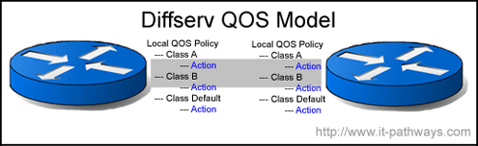
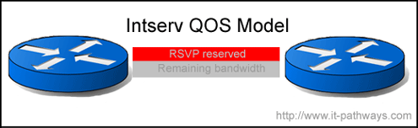
Two QoS models
IETF work
DiffServ
IntServ

Slide 26
Motivation
Internet currently provides one single class of “best-effort” service
No admission control and no assurances about delivery
Existing applications are elastic
Tolerate delays and losses
Can adapt to congestion
Future “real-time” applications may be inelastic
Three possible services
best-effort (“elastic” app.)
hard real-time (“real-time” app.)
soft real-time (“tolerant” app.)

Slide 27
New Service Models
What is the basic objective of network design?
Maximize total bandwidth? Minimize latency?
Maximize user satisfaction – the total utility given to users
What does utility vs. bandwidth look like?
Must be non-decreasing function
Shape depends on application

Slide 28
Utility Curve Shapes
U
Elastic
U
Hard real-time
BW
BW
U
Delay-adaptive
Stay to the right and you are fine for all curves
BW

Slide 29
A Short History of Internet QoS
Lots of initial research in the late 80s and early 90s.
Often takes a telecommunications view of the network.
ATM QoS and Integrated services were developed based on these results.
Focus on per-flow, hard QoS.
Effort was driven by perceived application needs.
In the last few years, the focus has shifted towards Differentiated services.
Focus is on QoS for flow aggregates, e.g., all the flows belonging to one customer.

Slide 30
Unit 5 outline
5.1 multimedia networking applications
5.2 streaming stored audio and video
5.3 making the best out of best effort service
5.4 providing multiple classes of service
5.5 providing QoS guarantees

Slide 31
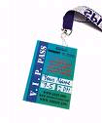
Providing Multiple Classes of Service
thus far: making the best of best effort service
one-size fits all service model
alternative: multiple classes of service
partition traffic into classes
network treats different classes of traffic differently (analogy: VIP service vs regular service)
granularity: differential service among multiple classes, not among individual connections
history: type of service (ToS) field in IPv4 header
0111

Slide 32
Multiple classes of service: scenario
H1
H3
R1
R2
H4
H2
R1 output
interface
queue
1.5 Mbps link
A simple network with two applications
The routers are connected by a 1.5 Mbps link
Assume the LAN speeds are significantly higher than 1.5 Mbps
Focus on the output queue of router R1 where packet delay and loss will occur

Slide 33
Scenario 1: mixed FTP and audio
Example: 1 Mbps IP phone, FTP share 1.5 Mbps link.
bursts of FTP can congest router, cause audio loss
want to give priority to audio over FTP
R1
R2
Principle 1
packet marking/classification needed for router to distinguish between different classes; and new router policy to treat packets accordingly

Slide 34
Principles for QoS Guarantees
what if applications misbehave (audio sends higher than declared rate)
policing: force source adherence to bandwidth allocations
marking and policing at network edge (end system/ edge router)
1 Mbps
phone
R1
R2
1.5 Mbps link
packet marking and policing
Principle 2
provide protection (isolation) for one class from others

Slide 35
Principles for QoS Guarantees (more)
Allocating fixed (non-sharable) bandwidth to flow: inefficient use of bandwidth if flows doesn’t use its allocation
1 Mbps
phone
1 Mbps logical link
R1
R2
1.5 Mbps link
0.5 Mbps logical link
Principle 3
While providing logical isolation, it is desirable to use
resources as efficiently as possible

Slide 36
Principles for QoS Guarantees (more)
Basic fact of life: can not support traffic demands beyond link capacity
1 Mbps
phone
R1
R2
1 Mbps
phone
1.5 Mbps link
Principle 4
Call Admission: flow declares its needs, network may
block call (e.g., busy signal) if it cannot meet needs

Slide 37
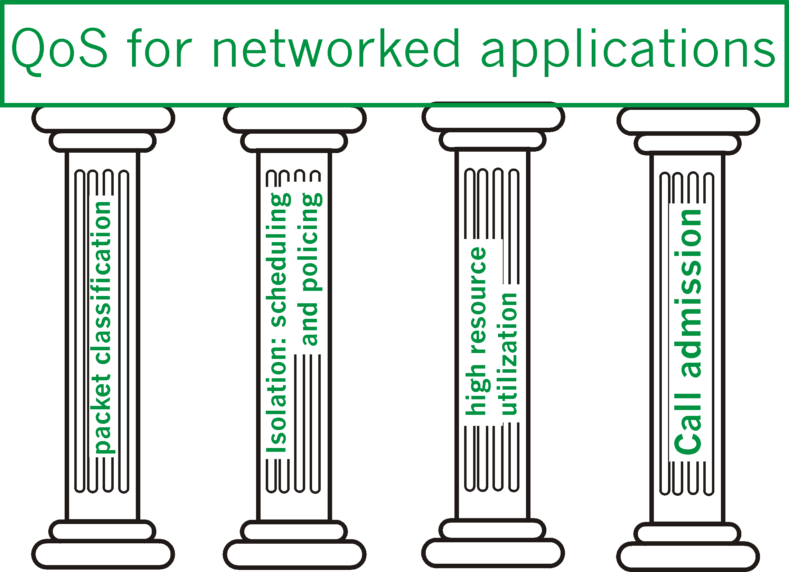
QoS Summary

Slide 38
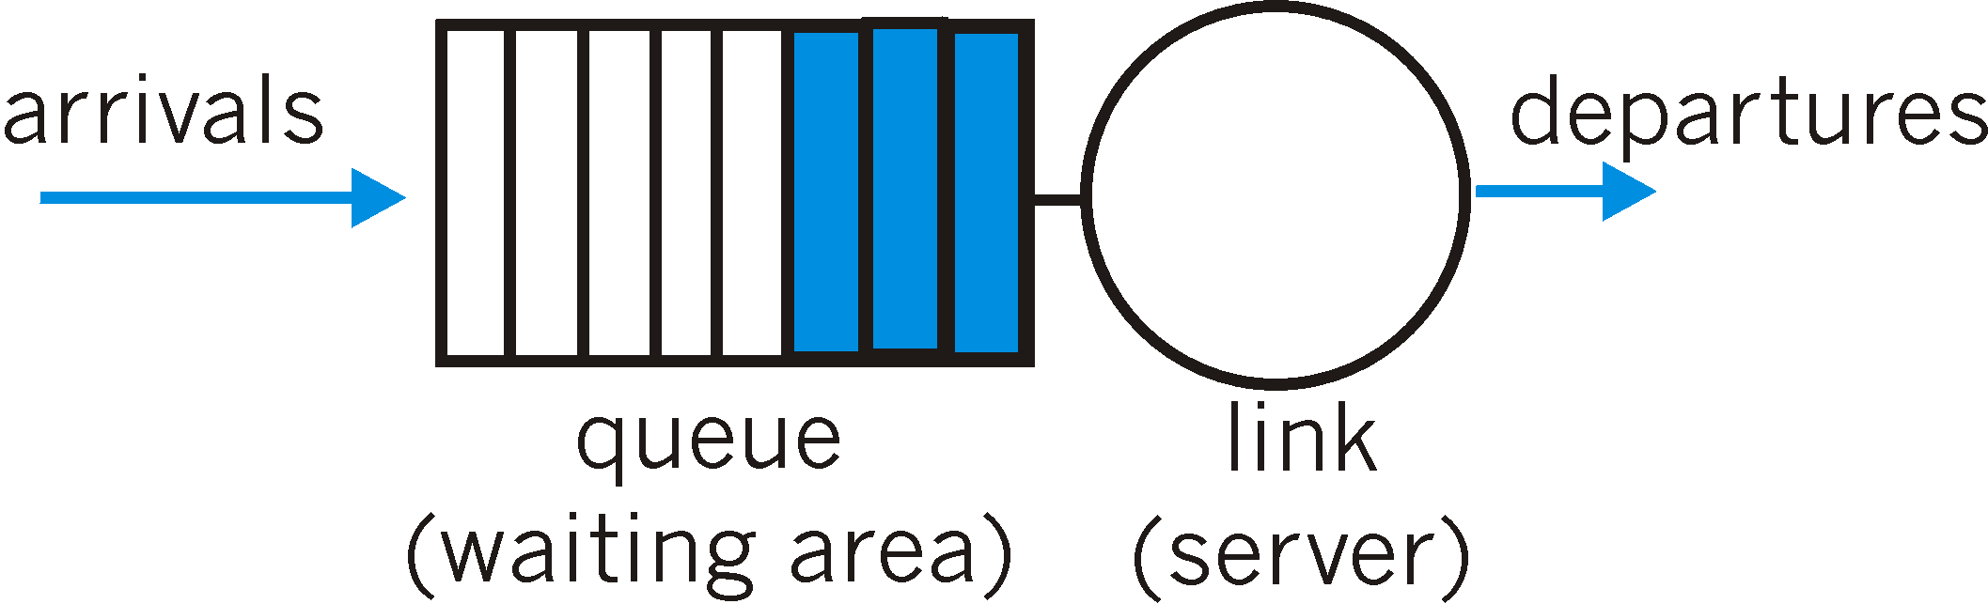
Scheduling And Policing Mechanisms
scheduling: choose next packet to send on link
FIFO (first in first out) scheduling: send in order of arrival to queue (not very fair)
real-world example?
discard policy: if packet arrives to full queue: who to discard?
Tail drop: drop arriving packet
priority: drop/remove on priority basis
random: drop/remove randomly

Slide 39
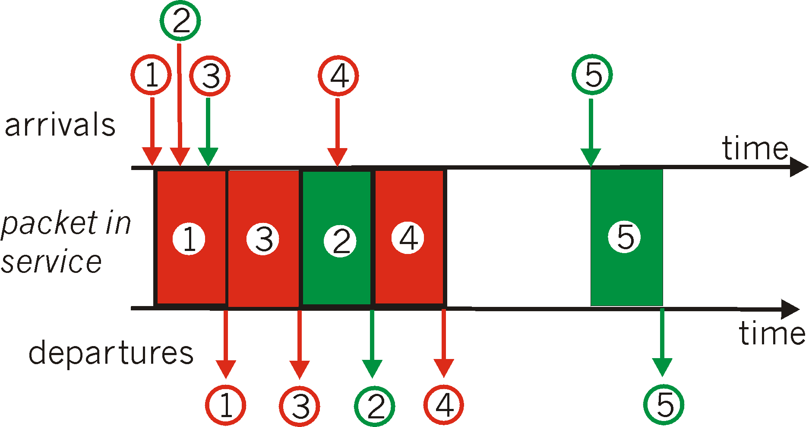
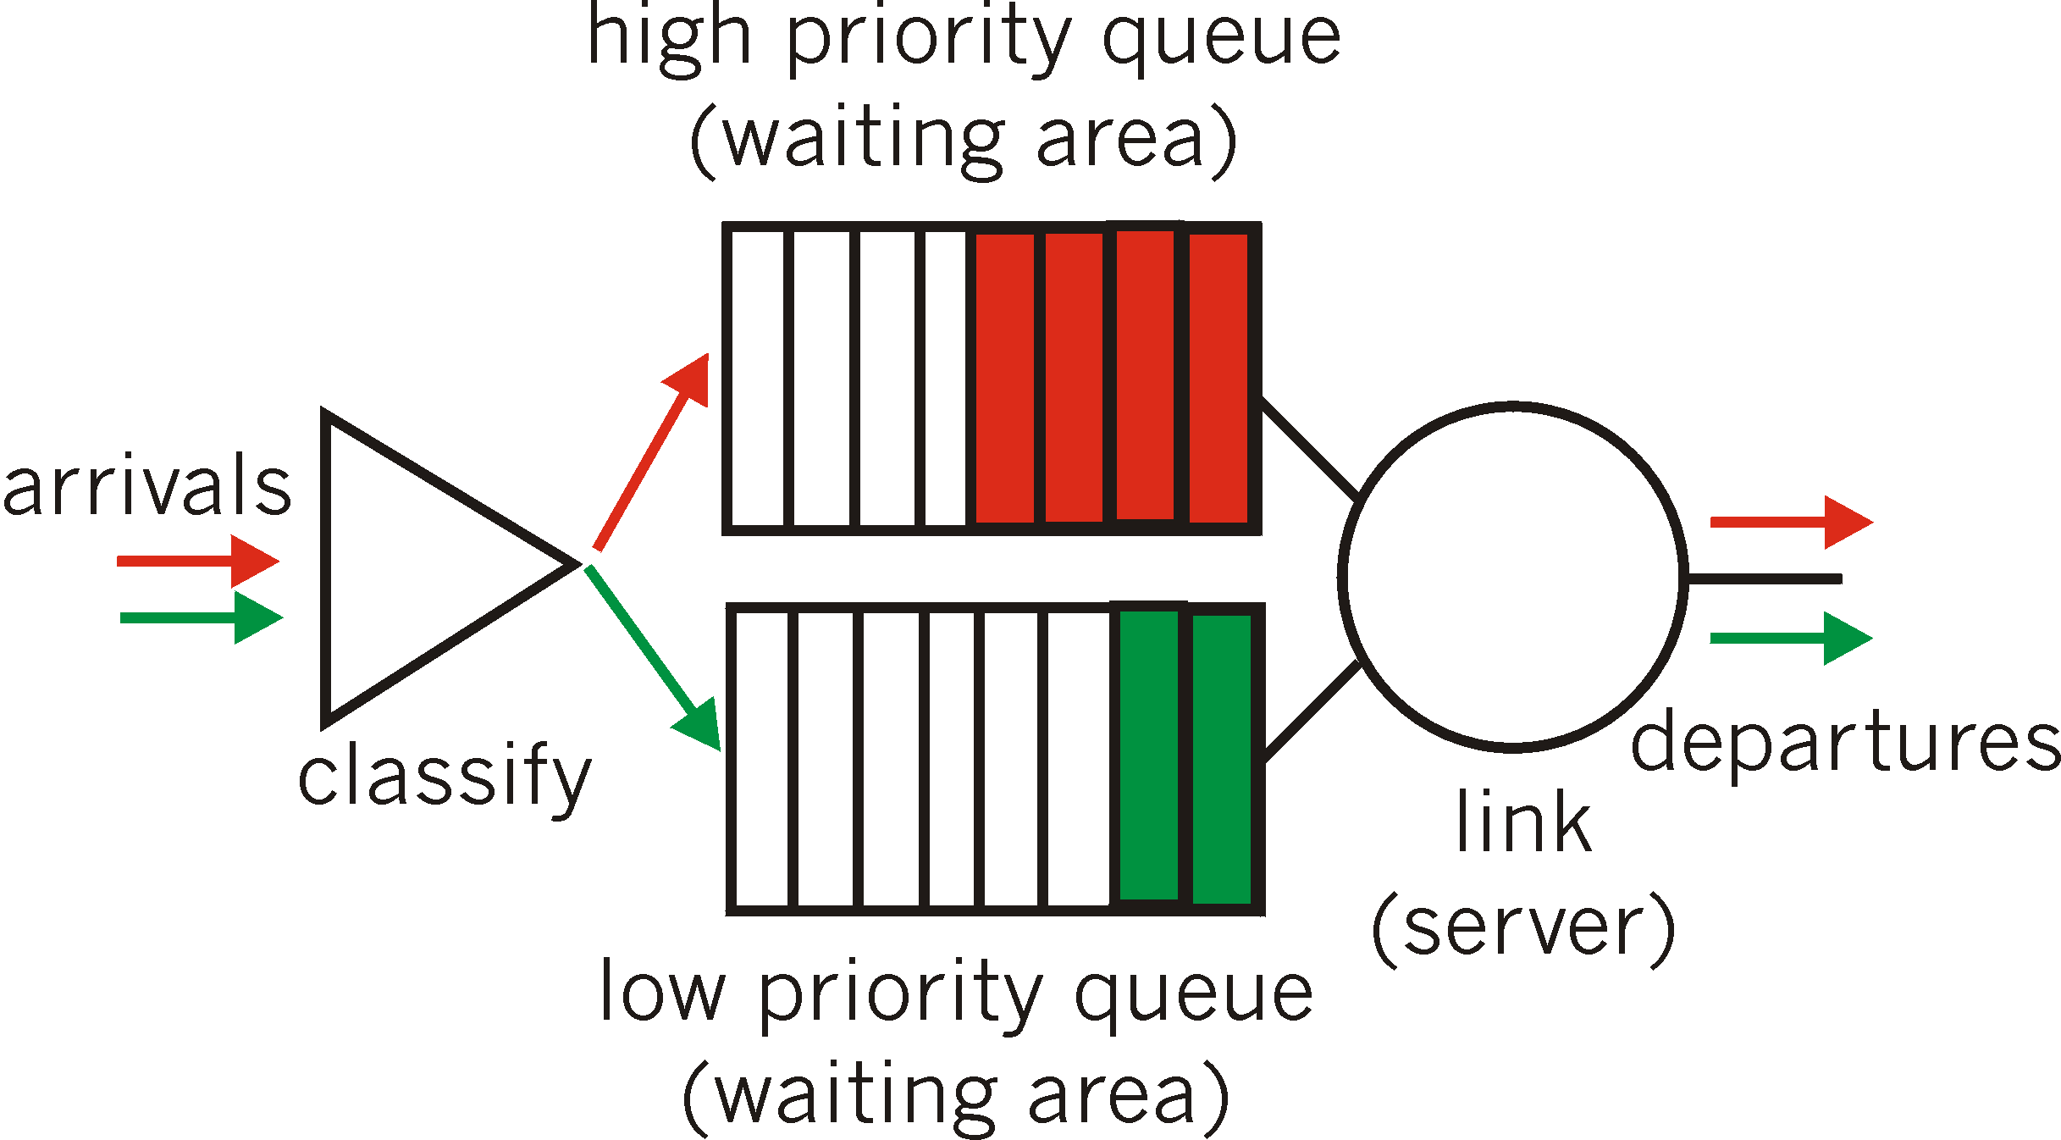
Scheduling Policies: more
Priority scheduling: transmit highest priority queued packet
multiple classes, with different priorities
class may depend on marking or other header info, e.g. IP source/dest, port numbers, etc..
Real world example?

Slide 40
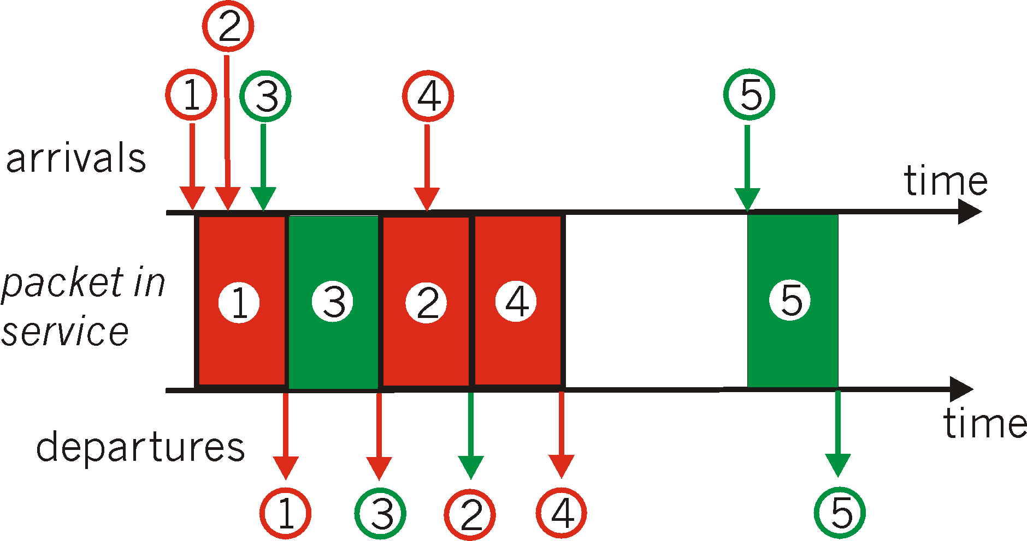
Scheduling Policies: still more
round robin scheduling / fair queuing:
multiple classes
cyclically scan class queues, serving one from each class (if available); if one class to be served is found none, immediately check the next class
unfair to short packets and has no priority

Slide 41
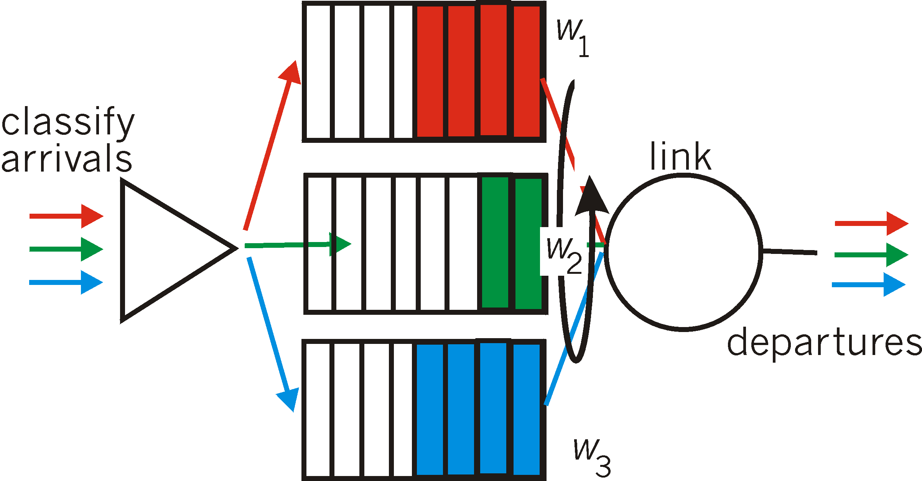
Scheduling Policies: still more
Weighted Fair Queuing (WFQ):
generalized Round Robin
each class gets weighted amount of service in each cycle
WFQ plays a central role in QoS architectures.
It is also available in today's router products

Slide 42
Weighted fair queuing (WFQ)
as in round robin scheduling, a WFQ scheduler will serve classes in a circular manner
differs from round robin in that each class may receive a differential amount of service in any interval of time
each class i is assigned a weight w_{i}
class i is guaranteed a fraction of service w_{i} /(Σw_{j})，
guaranteed bandwidth R_{i} for class i
for a link with transmission rate R
Equation (5-1)

Slide 43
Comparison between WFQ and FIFO (1)
Packets of class 1 consecutively arrive:
w₁=0.5, w_{i} = 0.05 (i=2 ~ 11)
Class 1
t
1
1
1
1
1
1
1
1
1
1
1
Class 2
2
t
…
Class 11
11
t
FIFO
t
1
2
3
4
5
6
7
8
9
10
11
1
1
1
1
1
1
1
1
1
1
WFQ
t
1
1
1
1
1
1
1
1
1
1
2
3
4
5
6
7
8
9
10
11
1

Slide 44
Comparison between WFQ and FIFO (2)
(b) Packets of class 1 arrive in a discrete manner:
w₁=0.5, w_{i} = 0.05 (i=2 ~ 11)
Class 1
1
1
1
1
1
1
1
1
1
1
1
t
Class 2
2
t
…
Class 11
11
t
FIFO
1
2
3
4
5
6
7
8
9
10
11
1
1
1
1
1
1
1
1
1
1
t
WFQ
1
2
1
3
1
4
1
5
1
6
1
7
1
8
1
9
1
10
1
11
1
t
Summary: in either case (a) or (b), FIFO results are the same; WFQ scheduler can always guarantee that packets in class 1 receive more services.

Slide 45
Policing Mechanisms
Goal: limit traffic to not exceed declared parameters
Three common-used criteria:
(Long term) Average Rate: how many pkts can be sent per unit time (in the long run)
crucial question: what is the interval length: 100 packets per sec (more constrained) or 6000 packets per min have same average!
Peak Rate: e.g., 6000 pkts per min. avg.; 1500 pkts per sec. peak rate
(Max.) Burst Size: max. number of pkts sent consecutively (with no intervening idle) over an extremely short interval of time

Slide 46
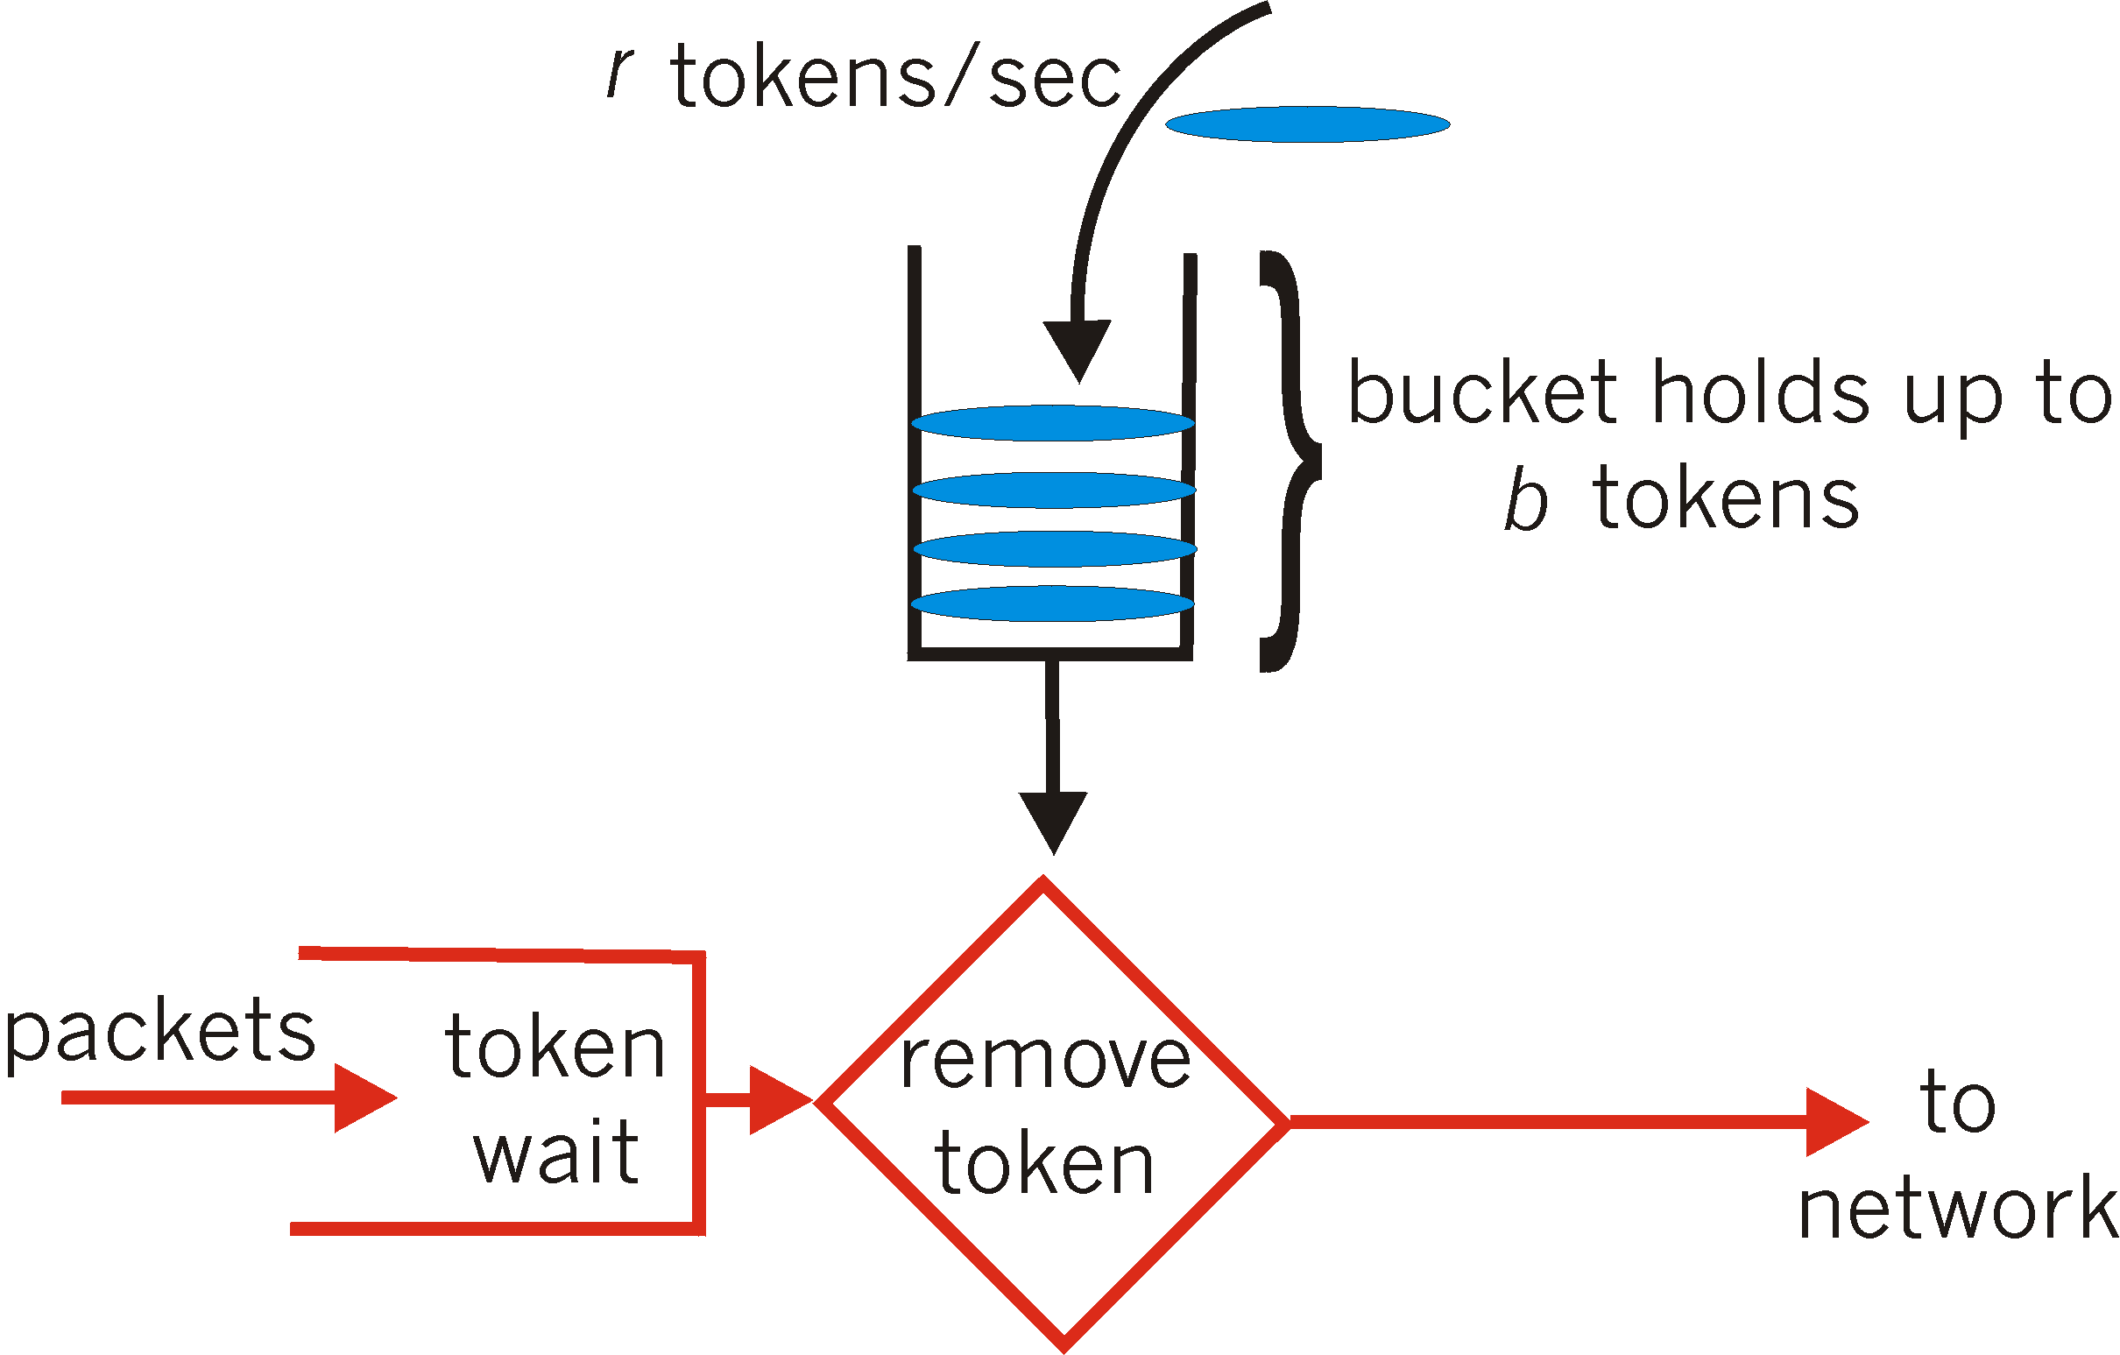
Policing Mechanisms
Token Bucket: limit input to specified Burst Size and Average Rate.
bucket can hold b tokens
tokens generated at rate r token/sec unless bucket full
over interval of length t: N_{packets admitted} ≤ (r t + b)
packets with tokens are admitted

Slide 47
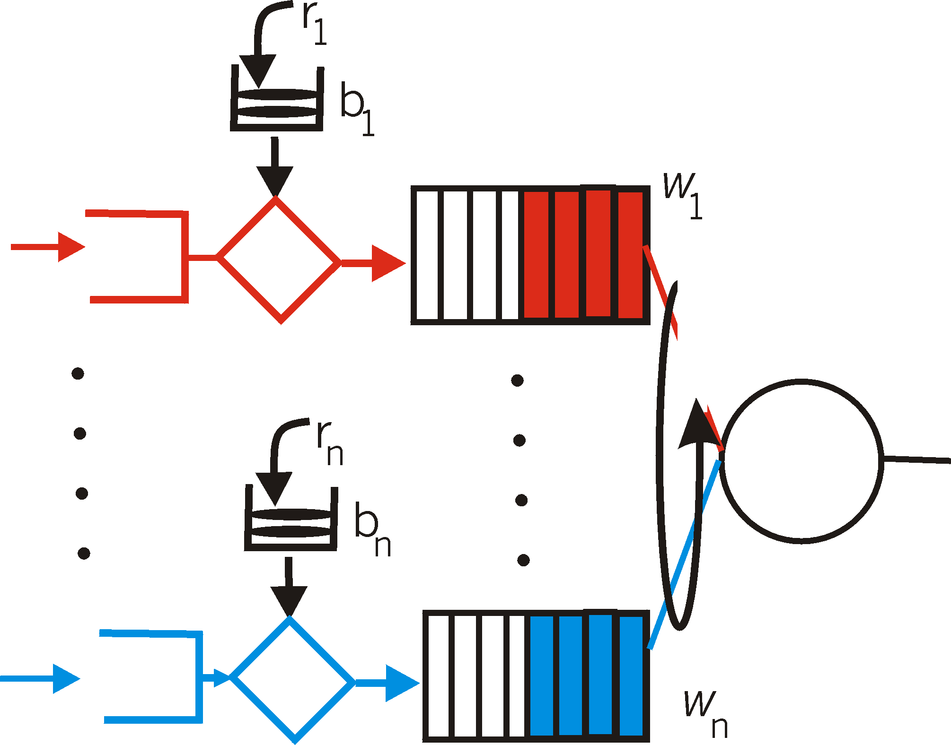
Policing Mechanisms (more)
token bucket, WFQ combine to provide guaranteed upper bound on delay, i.e., QoS guarantee!
arriving
traffic
token rate, r
class 1
bucket size, b
per-flow
rate, R
WFQ
WFQ
class n
Upper bound on delay
D = b/R
max
Last packet with token b experience the longest delay
R can be calculated according to equation (5-1)

Slide 48
IETF Differentiated Services
aims to handle different “classes” of traffic in a scalable and flexible manner
scalability: simple functions in network core, relatively complex functions at edge routers (or hosts)
Simpler signaling: (than RSVP) specify a more qualitative notion of service, better-than-best-effort
signaling, maintaining per-flow router state difficult with large number of flows
flexibility: don’t define specific service classes, but provide functional components to build service classes
new service classes may arise and old service classes may become obsolete
Notes:
obsolete
英 [ ˈɒbsəli:t ] 美 [ ˌɑ:bsəˈli:t ]
考研 GRE TOEFL IELTS
adj.废弃的 老式的，已过时的 [生]已废退的
n.废词 被废弃的事物
vt.淘汰 废弃

Slide 49
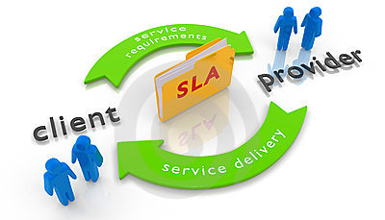
Service Level Agreement (SLA)
An SLA is a formal negotiated agreement.
service provider ↔ customers.
identify expectations
clarify responsibilities
facilitate communication
Quality of Service (QoS): the collective effect of service performance which determines the degree of satisfaction of a user of the service.
QoS Agreement: the part of SLA which refers to QoS, may include throughput, packet loss rate, delay, delay jitter and network availability, etc.

Slide 50
QoS control space
Time granularity
time
session
round trip
packet
object
host
packet
flow
flow
aggregation
edge router
core router
position

Slide 51

DiffServ Architecture
Edge router:
per-flow traffic management
packet classification and traffic conditioning
marks packets as in-profile and out-profile
marking
r
scheduling
.
b
.
.
Core router:
per class traffic management
buffering and scheduling based on marking at edge
forwarding
preference given to in-profile packets
DS Domain

Slide 52
Edge-router Packet Marking
profile: pre-negotiated rate A, bucket size B
packet marking at edge based on per-flow profile
Rate A
User profile
(token bucket)
B
in-profile traffic
User packets
out-of-profile traffic
Possible usage of marking:
class-based marking: packets of different classes marked differently
intra-class marking: conforming portion of flow marked differently than non-conforming one

Slide 53
Edge router: Classification and Conditioning
Packet is marked in the 8-bit Type of Service (TOS) in IPv4, and 8-bit Traffic Class in IPv6
6 bits used for Differentiated Service Code Point (DSCP) and determine Per-Hop Behavior (PHB) that the packet will receive
2 bits are currently unused

Slide 54
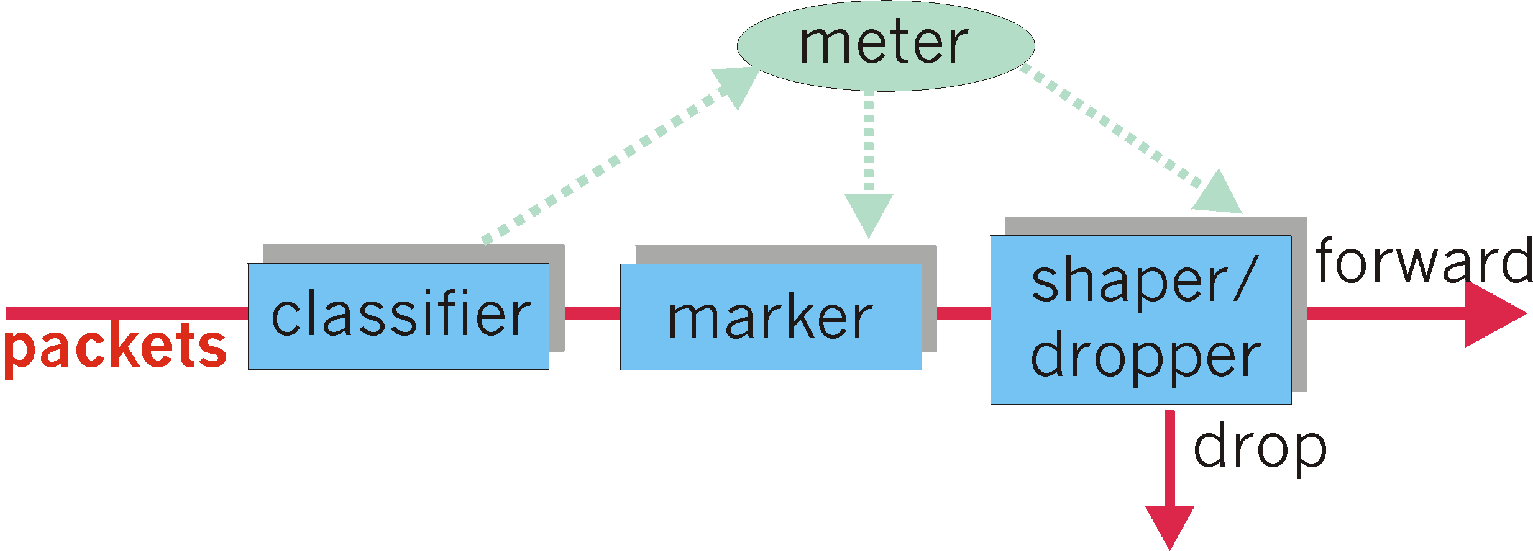
Edge: Classification and Conditioning (more)
may be desirable to limit traffic injection rate of some class:
user declares traffic profile (e.g., rate, burst size)
traffic metered, shaped if non-conforming
The role of metering function: to compare the incoming packet flow with the negotiated traffic profile.
conditioner

Slide 55
Core router
Routing
Messages
Routing
DSCP Pool
Per Hop Behavior
(PHB)
Control Plane
Forwarding Table
Data Plane
Data In
Route Lookup
Scheduler
Data Out

Slide 56
Core: Forwarding (PHB)
PHB result in a different observable (measurable) forwarding performance behavior
PHB does not specify what mechanisms to use to ensure required PHB performance behavior
No state info to be maintained by routers!
Examples:
Class A gets x% of outgoing link bandwidth over time intervals of a specified length
Class A packets leave first before packets from class B

Slide 57
Forwarding (PHB)
Two PHBs defined so far
Expedited Forwarding (EF or Premium): pkt departure rate of a class equals or exceeds (>=) a configured rate
logical link with a minimum guaranteed rate
low loss, low latency/delay, low jitter, end-to-end service through DS domains
Assured Forwarding (AF): divides traffic into four classes
0-2 bits of DSCP define 4 classes of traffic (001, 010, 011, 100)
each AF class is guaranteed to be provided with some minimum amount of bandwidth and buffering;
Notes:
premium
英 [ˈpri:miəm] 美 [ˈprimiəm]
n. 额外费用; 保险费; 附加费;
adj. 高昂的; 优质的;
变形 复数: premiums
expedite 搜索网络
英 [ˈekspədaɪt] 美 [ˈɛkspɪˌdaɪt]
vt. 加快进展; 迅速完成;
变形 过去分词: expedited 过去式: expedited 现在分词: expediting 第三人称单数: expedites

Slide 58
Premium Service Example
Drop always
Fixed Bandwidth

Slide 59
Assured Service Example
Drop if congested
Uncongested
Congested
Assured Service

Slide 60
Unit 5 outline
5.1 multimedia networking applications
5.2 streaming stored audio and video
5.3 making the best out of best effort service
5.4 providing multiple classes of service
5.5 providing QoS guarantees

Slide 61


QoS guarantee scenario
Resource reservation
call setup, signaling (RSVP)
traffic, QoS declaration
per-element admission control
request/
reply
QoS-sensitive scheduling (e.g., WFQ)

Slide 62
IETF Integrated Services
architecture for providing QoS guarantees in IP networks for individual application sessions
provides services on a per flow basis where a flow is a packet stream with common source address, destination address and port number
resource reservation: routers maintain per-flow state info of allocated resources, QoS req’s
admit/deny new call setup requests

Slide 63
Two key IntServ features
Reserved Resources
the router must know the amount of its resources currently reserved for on-going sessions
standard resources: link capacity, router buffers
Call Setup / call addimision
requires participation of each router on the path

Slide 64
Call setup details
steps in call setup process (Traffic characterization and specification of QoS) Arriving session must :
declare its QOS requirement by R-spec (R for reservation) defining the QOS being requested,
characterize traffic it will send into network by T-spec: defining traffic characteristics,
signaling protocol: needed to carry R-spec and T-spec to routers (where reservation is required), RSVP (ReSource reserVation Protocol),
Per-element call admission,
Once a router receives Rspec and Tspec for a session, it decides whether to admit the call.

Slide 65
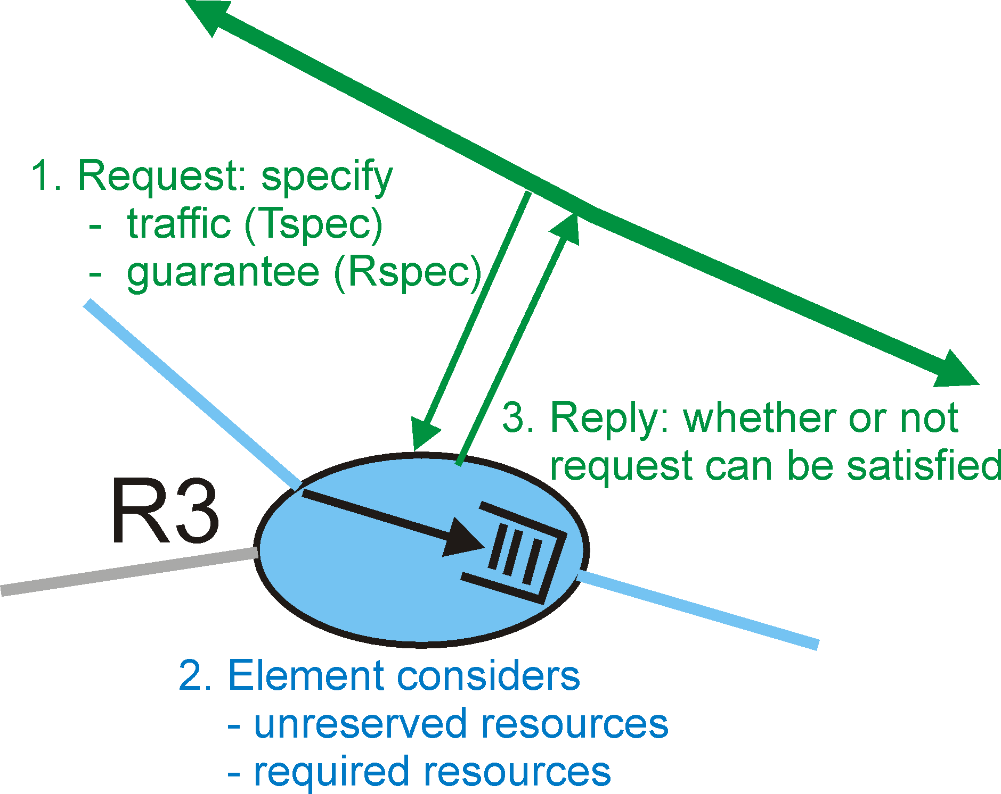
Call Admission
Call Admission: routers will admit calls based on their R-spec and T-spec and base on the current resource allocated at the routers to other calls.

Slide 66
Intserv QoS: three classes
Guaranteed service:
worst case traffic arrival: leaky-bucket-policed source
simple (mathematically provable) bound on delay
per flow control and schedule
Controlled load service:
Predictive or differentiated services
guarantee not as strong as with the guaranteed service
fine with lightly-loaded network, but the service degrades quickly as network load increases
per aggregate flow control and schedule
Best effort service
arriving
traffic
token rate, r
bucket size, b
per-flow
rate, R
WFQ
D = b/R
max

Slide 67
Signaling in the Internet
connectionless (stateless) forwarding by IP routers
no network signaling protocols
in initial IP design
+
best effort service
=
New requirement: reserve resources along end-to-end path (end system, routers) for QoS for multimedia applications
RSVP: Resource Reservation Protocol [RFC 2205]
known as a soft-state protocol, i.e., can expire
used to install state (bandwidth reservations) in routers
To implement RSVP, RSVP software must be present in the receivers, senders, and routers along the end-end path

Slide 68
Collaboration of function parts in IntServ router
Routing
Messages
Routing
RSVP
RSVP
messages
Admission
Control
Control Plane
Policy
Control
Forwarding Table
Per Flow QoS Table
Data Plane
Data In
Route Lookup
Classifier
Scheduler
Data Out
Admission control determines whether the node has sufficient available resources to supply the requested QoS.
Policy control determines whether the user has administrative permission to make the reservation

Slide 69
Role of RSVP
Rides on top of unicast/multicast routing protocols.
Must be present at sender(s), receiver(s), and routers.
Carries resource requests all the way through the network.
At each hop consults admission control and sets up reservation. Informs requester if failure.

Slide 70
Reservation Protocol: RSVP
Upper layer protocols and applications
IP service interface
IP
ICMP
IGMP
RSVP
Link layer service interface
Link layer modules

Slide 71
RSVP Design Goals
accommodate heterogeneous receivers (different bandwidth along paths)
accommodate different applications with different resource requirements
make multicast a first class service, with adaptation to multicast group membership
leverage existing multicast/unicast routing, with adaptation to changes in underlying unicast, multicast routes
control protocol overhead to grow (at worst) linear in # receivers
modular design for heterogeneous underlying technologies

Slide 72
RSVP: does not…
specify how resources are to be reserved
rather: a mechanism for communicating needs
determine routes packets will take
that’s the job of routing protocols
signaling decoupled from routing
interact with forwarding of packets
separation of control (signaling) and data (forwarding) planes

Slide 73
RSVP - Review
Concentration on multicast may have been wrong idea.
Unicast considered as special case of multicast.
Receiver initiation – handle negotiation at application level.
Receiver heterogeneity – how can low-capability receiver benefit from video sent at high bandwidth?
Layered encoding
Soft state
Hard state works in telephony network

Slide 74


Homework 1 of Unit 5
Compare three service models, i.e.,
best-effort service,
DiffServ
IntServ

Slide 75
Homework 2
How VoIP works?
http://www.eefocus.com/html/06-09/451s.shtml

Slide 76
Homework 3
How can CDN work? Describe CDN’s work principles.

Slide 77
Homework 4
Describe details of RSVP.

Slide 78
Homework 5
Investigate the application of three service models in the whole Internet.
Give a big picture about the coverage of each model / possibly more detailed statistical data.

Slide 79
Homework 6
Give your understanding about token bucket / leaky bucket
Principles
Usage

Slide 80
Homework 7
How many classes of services are provided by present Internet?

